Slide 1
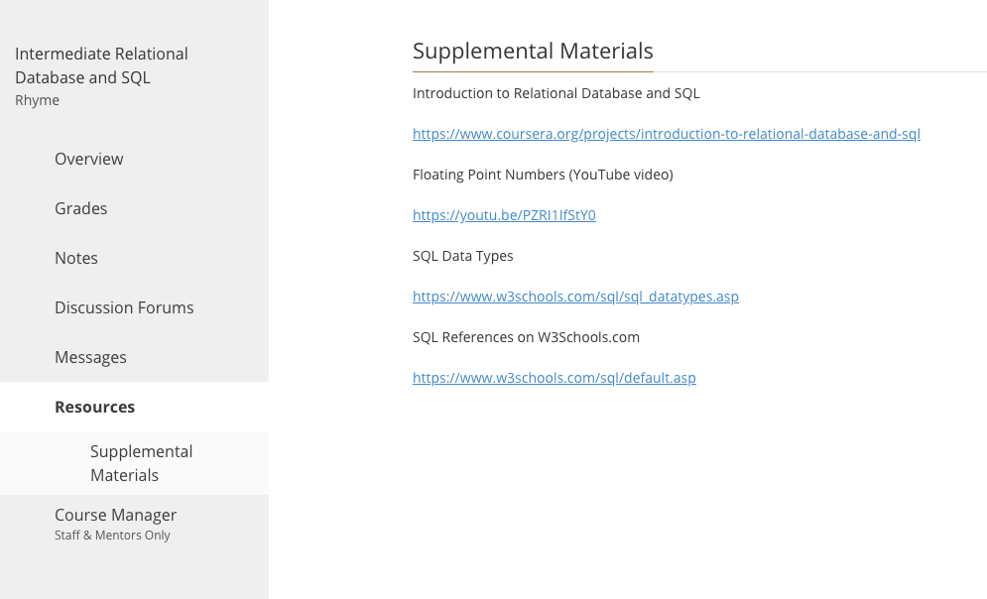
Intermediate Relational Database and SQL
Welcome!!

Slide 2


DATABASES
Collections of Related Data Items like Tables, Indexes, Constraints, etc...
Alumni
Admissions
Financial Aid
Billing
Academic
Icons made by Smashicons from www.flaticon.com

Slide 3
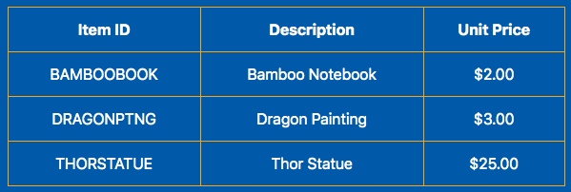
TABLES
COLUMNS, ROWS, KEYS, INDEXES
Icons made by Smashicons from www.flaticon.com

Slide 4
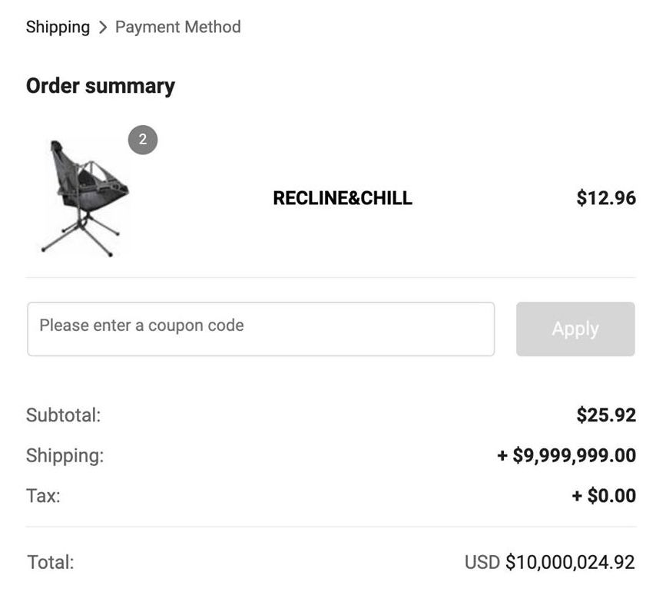
TABLES
Data Types
Strings
Fixed length
CHAR(10)
Strings
Variable length
VARCHAR(50)
Numbers
Integer
INT
But why?
It’s 2.00

Slide 5

TABLES
Data Types

Slide 6

Primary Key
MUST be unique values
Automatically indexed
Can span multiple columns
Slows insertion slightly
Can be specified when the table is created or added afterward
Primary Key
Speeds up lookups
Optional, but no more than 1

Slide 7
Index
CAN be unique values
Can span multiple columns
Slows insertion / update / delete
Can ONLY be added after the table is created
Index
Speeds up lookups
Can span multiple tables!
Optional, can have more than 1 per table

Slide 8
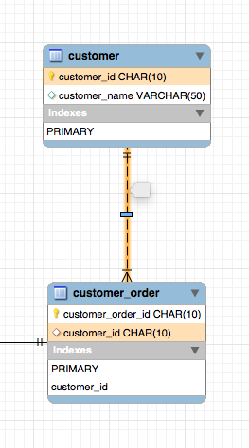
Foreign Key
Enforces table relations and
data integrity
Can span multiple columns
Can be specified when the table is created or added afterward
Always between TWO tables!

Slide 9

Foreign Key
Enforces table relations and
data integrity
Guest List
Can span multiple columns
Can be specified when the table is created or added afterward
Always between TWO tables!
Clipart by Vecteezy.com

Slide 10
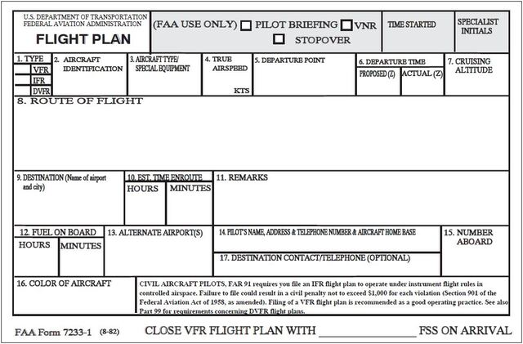
Foreign Key
Enforces table relations and
data integrity
Can span multiple columns
Can be specified when the table is created or added afterward
Always between TWO tables!

